Slide 1

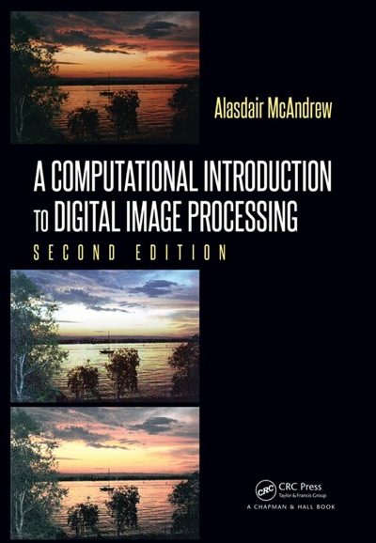
Chapter 2
Image Files and File Types

Slide 2

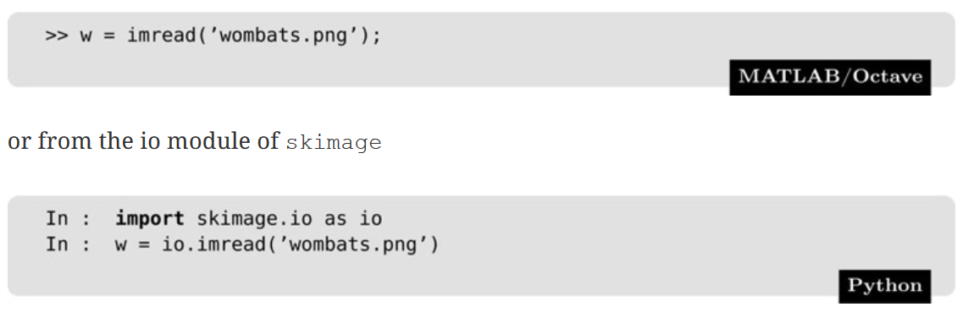
Opening and Viewing Grayscale Images
Images may be considered matrices whose elements are the pixel values of the image.
The semicolon has the effect of not displaying the results of the command to the screen.
This takes the gray values of all the pixels in the grayscale image wombats.png and puts them all into a matrix w. This matrix w is now a system variable, and we can perform various matrix operations on it.

Slide 3
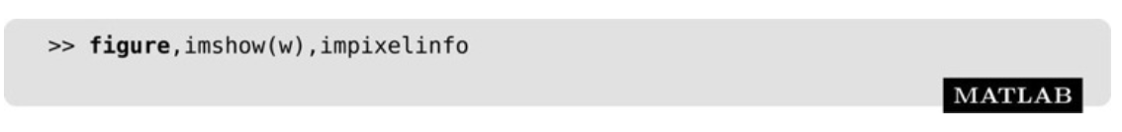
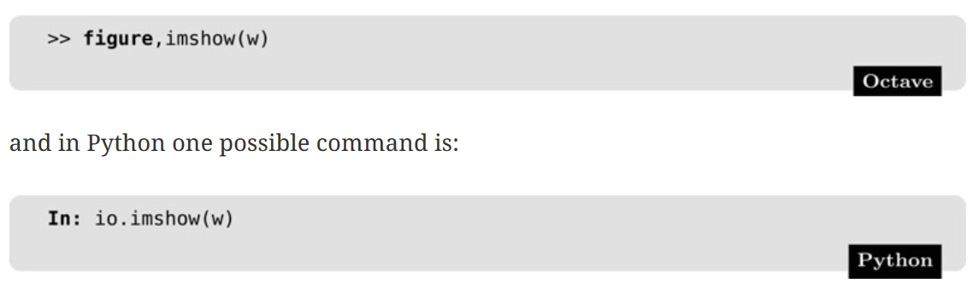
Opening and Viewing Grayscale Images
To display the matrix as a grayscale image:
figure: Creates a figure on the screen. A figure is a window in which a graphics object can be placed.
imshow(w): Displays the matrix w as an image.
impixelinfo: Not currently functional in Octave. Will display the gray values of the pixels in the image. They appear at the bottom of the figure in the form.

Slide 4
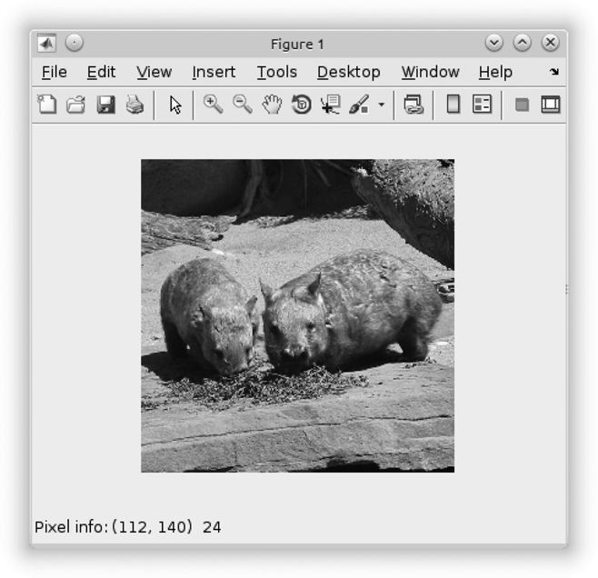
Opening and Viewing Grayscale Images
Grayscale image:
c is the column value of the given pixel; r is its row value, and p is its gray value. Since wombats.png is an 8-bit grayscale image, the pixel values appear as integers in the range 0–255.

Slide 5
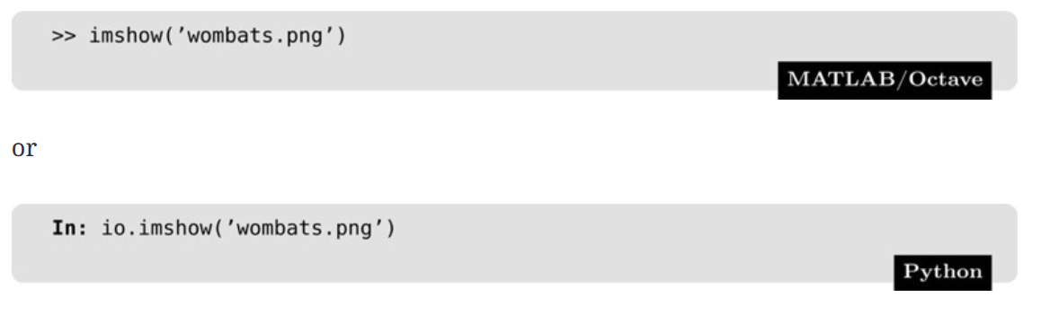
Opening and Viewing Grayscale Images
We could display this image directly, without saving its gray values to a matrix, with the command

Slide 6
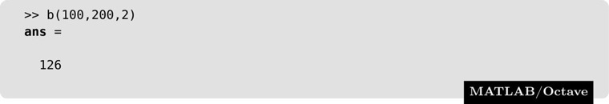
RGB Images
A standard model for defining color is RGB.
Pixel values consist of a list of three values, giving the red, green, and blue components of the color of the given pixel.
To obtain any of the RGB values at a given location, we use indexing methods. For example:
Returns the second color value (green) at the pixel in row 100 and column 200 of the image matrix stored in variable b

Slide 7
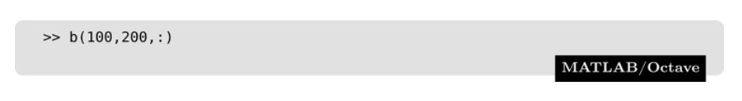
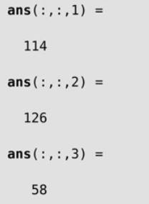
RGB Images
MATLAB and Octave allow a convenient shortcut for listing all values along a particular dimension just using a colon:

Slide 8
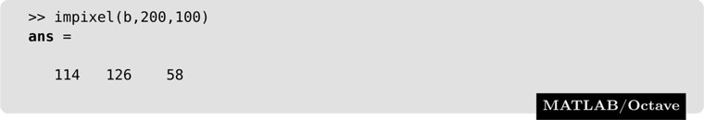
RGB Images
impixel function:
Returns the red, green, and blue values of the pixel at column 200, row 100. Notice that the order of indexing is opposite to the row, column order for matrix indexing.

Slide 9
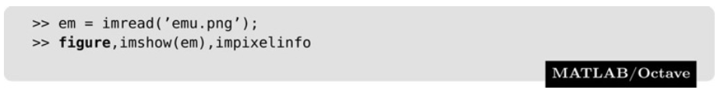
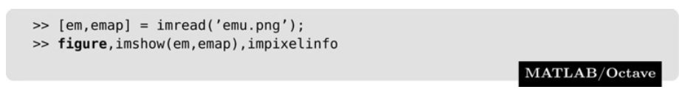
Indexed Color Images
Indexed Color Images: Consists of two matrices - a color map, and an index to the color map.
Assigning the image to a single matrix picks up on the index.
Instead of:
Use:

Slide 10
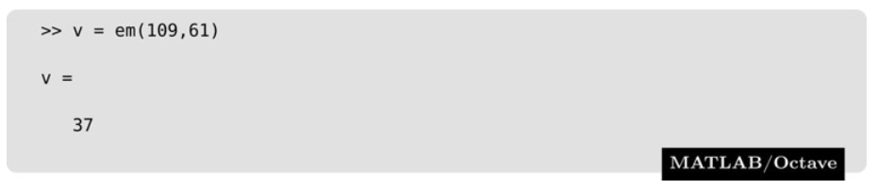
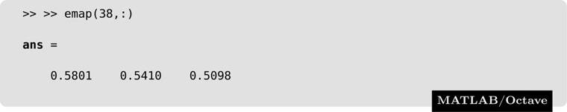
Indexed Color Images
MATLAB and Octave store the RGB values of an indexed image as values of type double, with values between 0 and 1. To obtain RGB values at any value:
To find the color values at this point, note that the color indexing is done with eight bits, hence the first index value is zero. Thus, index value 37 is in fact the 38th row of the color map:

Slide 11
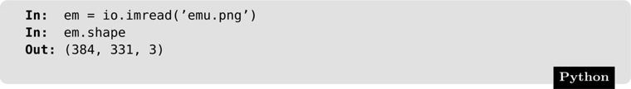
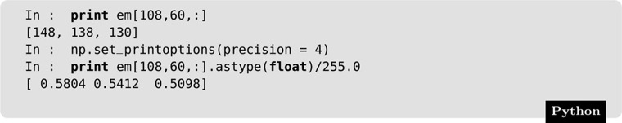
Indexed Color Images
Python automatically converts an indexed image to a true-color image as the image file is read:
To obtain values at a pixel :

Slide 12
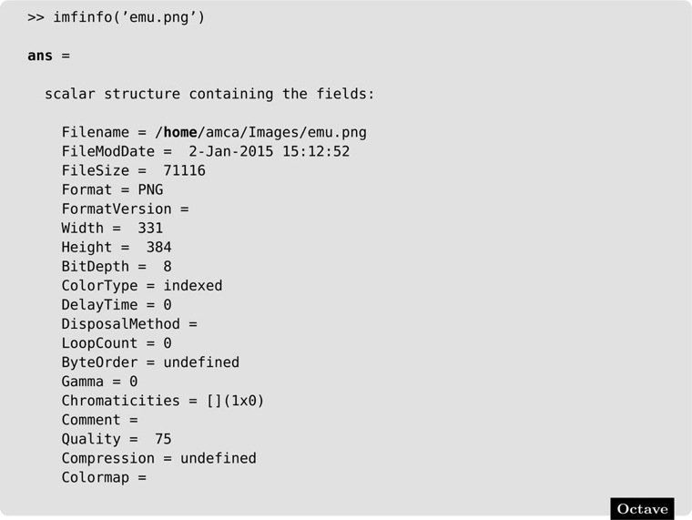
Image Information
size in bytes
number of bits per pixel
color type
(For saving of space, the colormap, which is given as part of the output, is not listed here.)

Slide 13
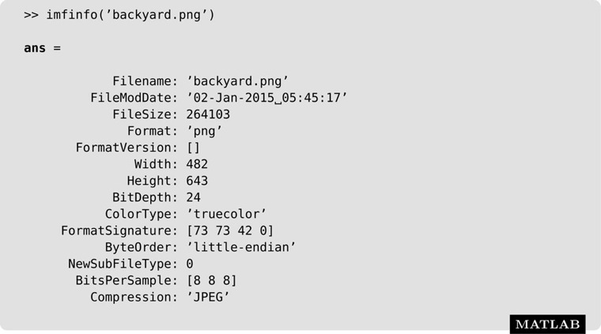
Image Information
The MATLAB and Octave outputs are slightly different:

Slide 14
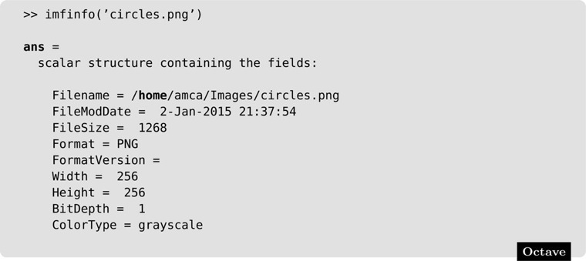
Image Information
Binary image:
Grayscale + BitDepth of 1 => black and white (binary)

Slide 15
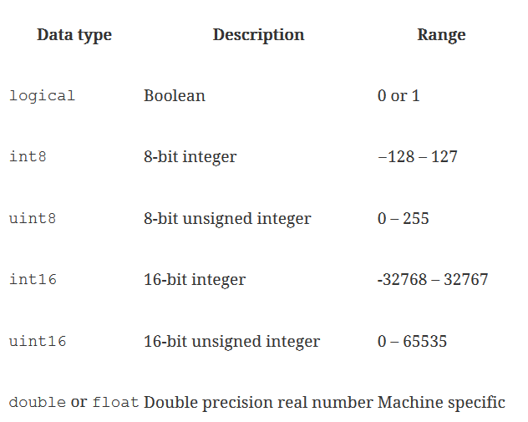
Numeric Types
Elements in an array representing an image may have a number of different numeric data types; the most common are listed below.

Slide 16
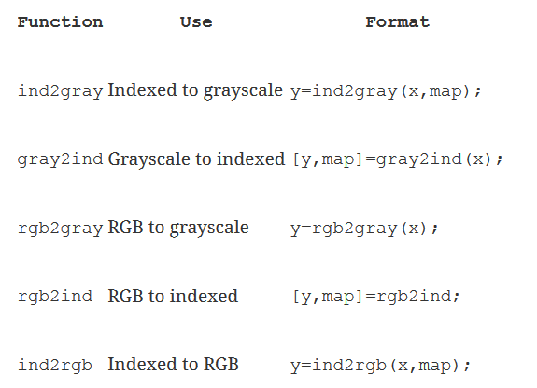
Converting Images

Slide 17
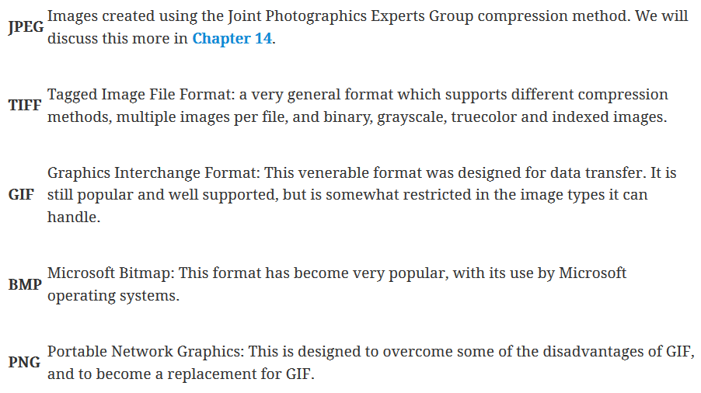
Image File Formats

Slide 18
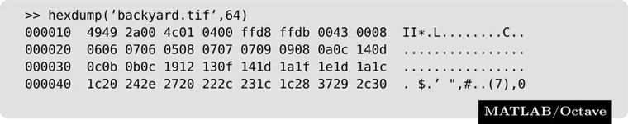
Hexdump
To explore binary files, we need a simple function that will enable us to list the contents of the file as hexadecimal values.
Three columns:
1) Hexadecimal value of the index of the first byte in that row
2) The bytes themselves
3) Bytes that are representable as ASCII text.
Hexdump function given in the book, available in D2L and y drive

Slide 19
Vector vs. Raster Images
Vector: Image is stored as a collection of lines or vectors.
Resizes without losing sharpness.
Difficult to represent natural scenes.
Raster: Image is stored as a collection of dots.
Most images stored as raster.
Resizing may result in a loss of quality

Slide 20
Raster Format
Image file header information may include
Size of the image
Documentation
Color map
Compression

Slide 21
ASCII PNM Format
ASCII PNM (Portable aNy Map Format): Group of generic formats (PGM, PPM, & PBM) used for conversion between other formats.
MATLAB and Octave can read PNM images natively; Python can't.
Why PNM?
Conversion among 40 different formats could have
40 × 39 = 1560 different conversion routines;
with PGM, 40 × 2 = 80 conversion routines between each format and PGM.

Slide 22
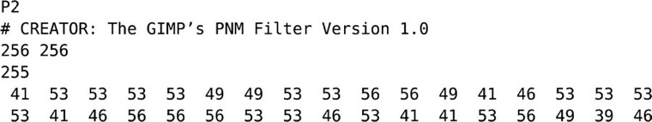
ASCII PGM Format
Indicates that this is a PGM (Portable GrayMap) file
Number of columns and rows
Number of grayscales
Pixel Information

Slide 23
ASCII PGM Format
Advantage: Very easy to write to and to read from
Disadvantage: Very large files
Some space can be saved by using “raw” PGM; the only difference is that the header number is P5, and the pixel values are stored one per byte.
Corresponding formats:
Binary - PBM (Portable BitMap; black and white)
Colored images – PPM (Portable PixMap; color)
Stored as three matrices: red, green, blue
The format does not support color maps.

Slide 24
Common Image Formats
BMP: Microsoft Bitmap. Binary image format (here binary means non-asci).
GIF: Graphics Interchange Format. (pronounced “jif”) First proposed in the late 1980s as a means for distributing images over networks.
Colors are stored using a color map; max of 256 colors
Doesn't allow for binary or grayscale images; except as can be produced with red, green, and blue values.
Pixel data is compressed using LZW (Lempel-Ziv-Welch) compression – lossless, original information can be recovered completely.
Allows for multiple images per file; this aspect can be used to create “animated GIFs.”

Slide 25
Common Image Formats
PNG: Portable Network Graphics (pronounced “ping”) format has been more recently designed to replace GIF.
Does not rely on any patented algorithms
Supports grayscale, true-color, and indexed images
Compression utility, zlib, always results in genuine compression* (Lossless)
Supports alpha channels, which allows variable transparencies with an image
Supports gamma correction, which helps ensure that a given image will appear the same independently of the display system
* This is not the case with LZW compression; it can happen that the result of an LZW compression is larger than the original data.

Slide 26
Common Image Formats
JPEG: Joint Photographics Experts Group. Binary image format (here binary means non-asci).
Uses lossy compression – not all original data can be recovered; much higher compression rates.
Not generally suitable for scientific data.
Good for digital display.
TIFF: Tagged Image File Format. One of the most comprehensive image formats.
Can store multiple images per file.
Allows different compression routines.
Allows different byte orderings (little-endian or big-endian).
Supports binary, grayscale, truecolor or indexed.
Supports opacity or transparency.

Slide 27
Writing Image Files
An image matrix may be written to an image file with:
where abc may be any of the image file types recognized by the system: gif, jpg, tif, bmp, for example.
For an indexed image:

